Slide 1
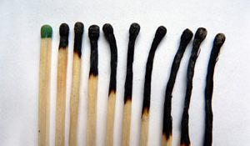
Le surmenage professionnel chez le personnel navigant
Emilie Dessy, M.Psy, PhD
Maj. Avi. Frederic Detaille, M.Sc HF
Royal Military Academy
LIFE Department
Research unit « VIPER »

Slide 2
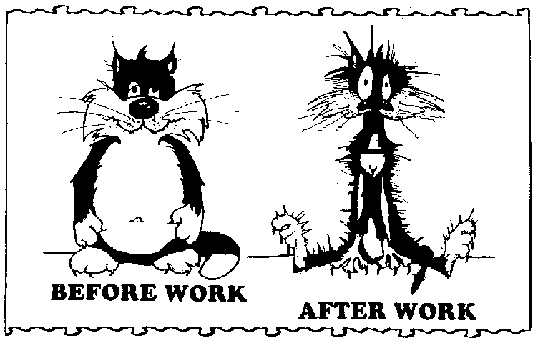
Contents
Definition
Symptoms
Differential diagnoses
Diagnostic procedure
Prevalence
Risk factors
Interventions
Back to work?

Slide 3
1. definition

Slide 4
Definition
Concept introduced for the first time in 1974 by Dr. Freudenberger
Terminology created by caregivers for caregivers
Christina Maslach’s work (“Maslach Burnout Inventory”, MBI) = reference for burnout
Burnout not officially diagnosed in the ICD-10 or the DSM-V
Tangle of definitions & descriptions
Netherlands ≠ Switzerland ≠ Germany ≠ Japan
Notes:
Burnout not officially diagnosed in the standard medical classifications of the International Classification of Diseases (ICD-10) of the World Health Organization, and the Diagnostic and Statistical Manual of Mental Disorders (DSM-V) of the American Psychiatric Association.
DSM-V (french version = may 2013) → controversial
En France, ce n’est qu’en 1982 que l’Assemblée nationale a voté la dépénalisation de l’homosexualité. Avec l’abrogation de l’article 332-1 du code pénal, l’homosexualité n’est plus considérée comme un délit. Elle sort par ailleurs de la liste des maladies mentales établie par le DSM-III (manuel diagnostique et statistique des troubles mentaux) en 1987 et de la Classification internationale des maladies de l’Organisation mondiale de la santé (OMS) en 1992.

Slide 5
Belgian Superior Council of Health’s Burnout definition
Burnout = Multifactorial process
Burnout → results from prolonged exposure (> 6months) in work situation to:
persistent stress,
lack of reciprocity between investment (work requirements, demands) and what is received in return (resources),
an imbalance between expectations and the reality of the lived work
Burnout → causes :
A professional exhaustion (at the same time emotional, physical and psychic),
an extreme tiredness
usual rest periods are not enough any more to relieve
becomes chronic
a feeling of being totally drained of its resources.
Notes:
Multifactorial process resulting from prolonged exposure (> 6months) in work situation to persistent stress, lack of reciprocity between investment (work requirements, demands) and what is received in return (resources), or an imbalance between expectations and the reality of the lived work, which causes a professional exhaustion (at the same time emotional, physical and psychic), an extreme tiredness that the usual rest periods are not enough any more to relieve and which becomes chronic as well as a feeling of being totally drained of its resources.

Slide 6
Belgian Superior Council of Health’s Burnout definition
Burnout = impact:
The control of emotion
The control of cognition
Behaviors
Attitude
The individual will
Stand out
Become cynical
Disengage from work
Decrease investment
Put entourage at distance
Develop a feeling of professional inefficiency
! This state of mind is also often not noticed by the worker for a long time !
Notes:
This exhaustion can also have an impact on the control of one's emotions (irritability, anger, crying ...) and one's cognitions (attention, memory, concentration) and can in turn cause changes in behaviors and attitudes. The person stands out and becomes cynical (mental distancing). It would actually be an (ineffective) accommodation to the demands that the person no longer faces. Gradually, she disengages from her work, decreases her investment and puts her entourage at a distance, or even develops pejorative conceptions about the people with whom she works. This results in a feeling of professional inefficiency (decreased work performance, low self-esteem, the person does not feel more effective in his work).

Slide 7
4 Stages that lead to burnout
Idealistic enthusiasm for work
Crack in the ideal
Contradictions → doubt about idealization → distress → can lead to an an excessive work rate
Protective withdrawal
Need to protect himself → cynic, emotional withdrawal, automation,…
Burnout
Notes:
4 main stages that lead to burnout:
An idealistic enthusiasm for work: Work is perceived as a privileged means of accomplishment (Delbrouck, Vénara, Goulet and Ladouceur, 2011). Which gives the worker a lot of energy (Social Affairs Commission, 2017).
2) A crack in the ideal: Faced with the contradictions present in the professional circles (conflict of values, moral dilemmas), the doubt as to the veracity of the ideal settles (Périlleux and Vendramin, 2017). But the end of idealization is distressing (Daloz, 2007). To no longer think about it the worker is involved in an excessive work rate (Périlleux and Vendramin, 2017).
3) A protective withdrawal: In the face of ideals that are becoming fragile, the worker feels a growing need to protect himself. He prefers to become cynical. The detachment allows to hold for a time, automating and anesthetizing the thought and the feelings (Perilleux and Vendramin, 2017). The attacks are generalized to the private life (Daloz, Balas & Bénony, 2007).
4) Burnout: If the situation persists, the ideal of a fulfilling job disappears completely (Daloz, 2007). A critical episode often marks the transition to proven burnout (Périlleux and Vendramin, 2007).

Slide 8
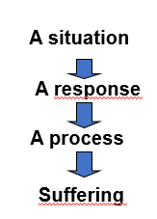
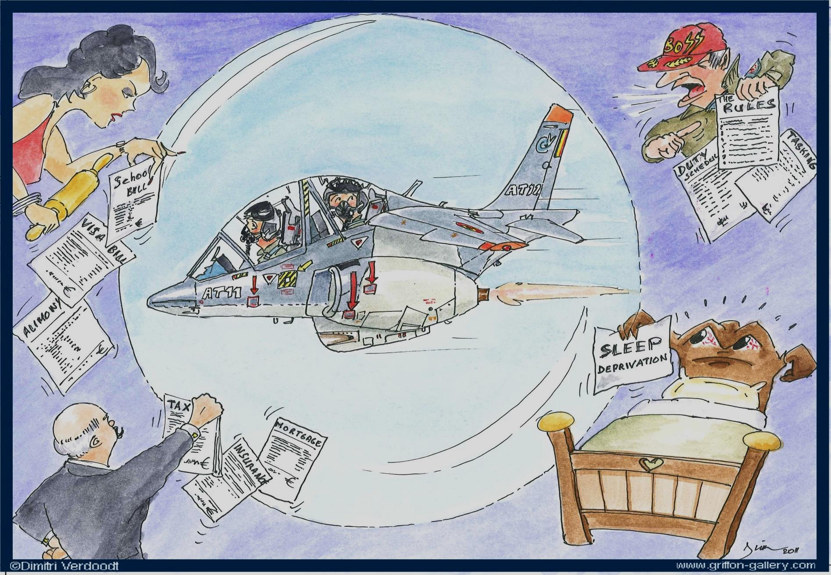
Burn-out process

Slide 9
A situation
Reality shock
Despite the motivation
Despite the Investment/ sacrifices
Some grumble all the time and are never happy
Lack of recognition
Etc.

Slide 10
Response (s)
Initially, these are normal and healthy adaptive responses:
Resist emotionally
Take a distance (less involved)
Reduce your ambitions (to be more realistic)
Notes:
1) Resist emotionally (protection against negative affects) → if repetition → protection also against positive affects → progressive depletion of emotional resources
2) A response → less involved → to worry without getting involved (empathy and non compassion) → leave your apron at the cloakroom when you have finished working
Put distance with the others + set limits

Slide 11
Response (s) vs Process(es)
If repeated, the process starts and can affect all areas of life:
Resist emotionally
If repetition: protection against both the positive and negative affects
Take a distance (less involved)
If repetition: dehumanization of relationships, cynicism, lack of social support
Reduce your ambitions (to be more realistic)
If repetition: demotivation, reduced self-esteem
Notes:
1) Resist emotionally (protection against negative affects) → if repetition → protection also against positive affects → progressive depletion of emotional resources
2) A response → less involved → to worry without getting involved (empathy and non compassion) → leave your apron at the cloakroom when you have finished working
Put distance with the others + set limits

Slide 12
Process
This process is favorized by the contemporary organization of work
No moods, business is business
It's the business that counts
Achieve the goals set by the company (not by you)

Slide 13
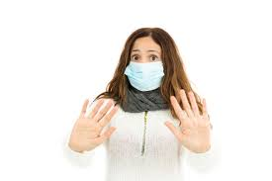
ATTENTION
Burn-Out syndrome can be contagious!
One is reached, he is absent, he increases the load of everyone, a second collapses, etc ...
Burn-Out syndrome is a problem not only for the individual but also for the institution!

Slide 14
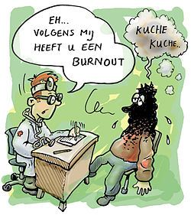
2. Symptoms
Several types of symptoms
Components vs consequences?
These can be physical, emotional, cognitive and behavioral

Slide 15
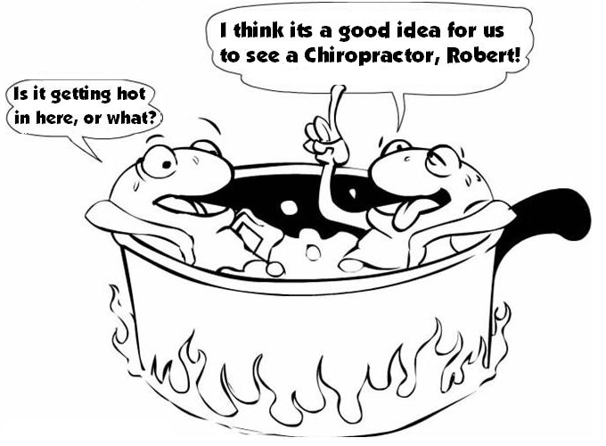
Physical symptoms
mainly sleep disorders and chronic fatigue
sleep no longer restaurative
Muscle tension with spinal pain (back, neck)
Appetite disturbances, stomach pains, nausea, dizziness, taking or loss sudden weight
Headaches
Weaken immune system

Slide 16
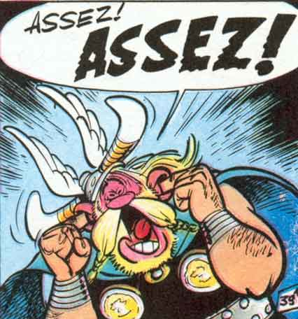
Emotional symptoms
anxiety,
irritability,
nervous tension,
depressed mood,
etc.
! The individual may also show no emotion !

Slide 17
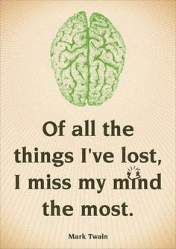
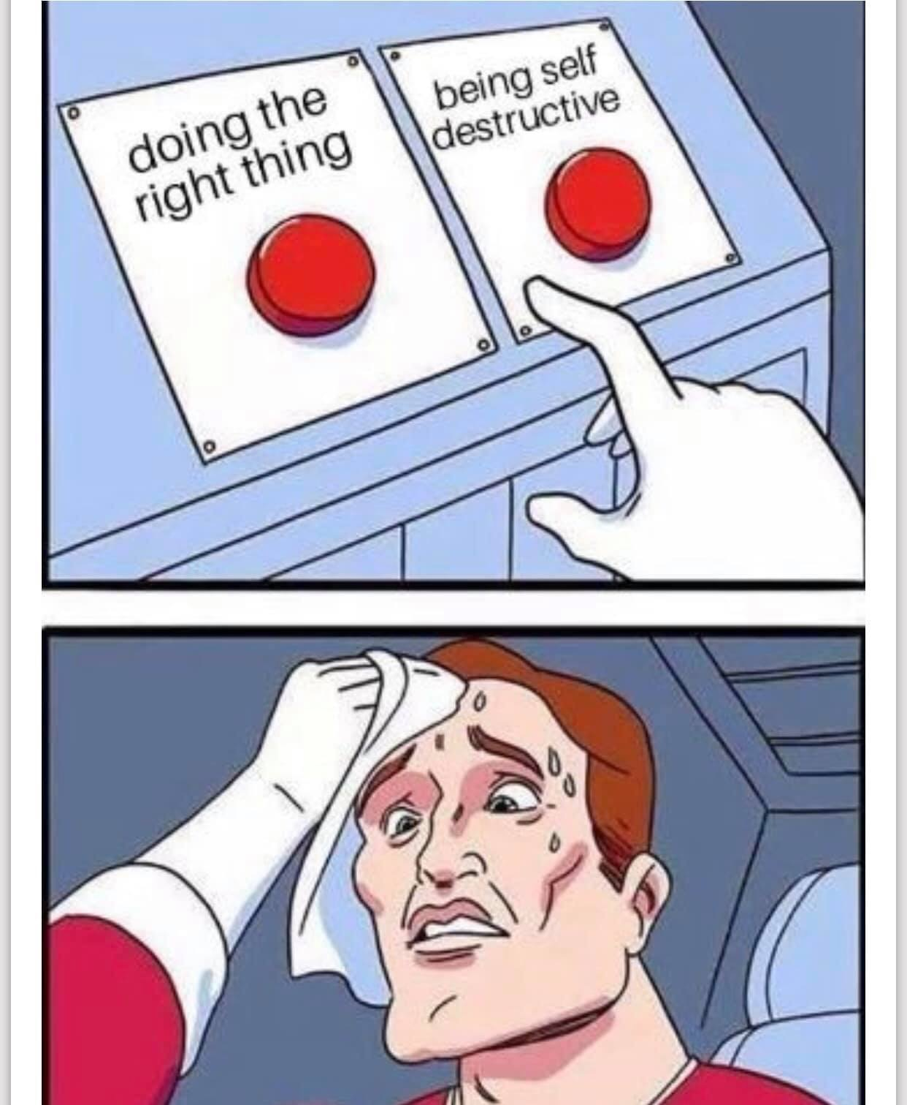
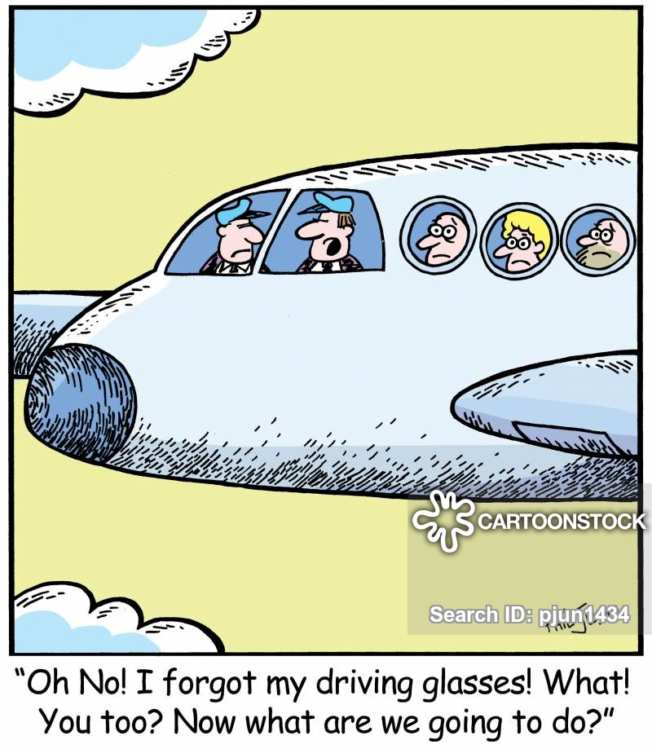
Cognitive symptoms
Reduced information processing capacities
Concentration ,
Multi-tasking,
Decision-making,
Memory,
Etc.

Slide 18
Behavioural symptoms
cynicism,
indifference,
loss of empathy,
isolation,
aggressive behavior (decreased tolerance to frustration),
disengagement,
low self-esteem,
addictive behaviors (performance increase or stress reduction)
Etc.

Slide 19
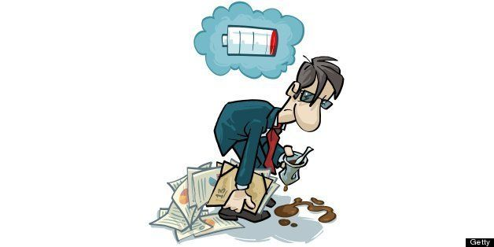
Clinical model
Appearance: the "Sheila’s facelift"
Essential signs
fatigability
Immediate memory disorders and concentration
Irritability
Accessories signs
Exhaustion
Wake up 4am
Phobia of crowds

Slide 20
3. Differential diagnoses
Burnout = medical diagnosis of exclusion
A thorough differential diagnosis of psychiatric, internal and neurological diseases must be established
Major depression and anxiety disorders must be ruled out
Organic pathologies such as endocrine disorders (hypothyroidism), neurological, oncological, infectious (Lyme), sleep (apnea, etc.), cardiac,… must be ruled out
≠ workaholism and stress
Burnout can be diagnosed in // with other psychiatric disorder such as depression
In the presence of a psychiatric secondary illness resulting from the burnout → pronounced exhaustion component can be observed
Notes:
Since exhaustion and other symptoms are not specific to this syndrome, it is not officially diagnosed in the medical reference classifications and has no established diagnostic tool; burnout is therefore a medical diagnosis of exclusion that must be made as part of a more complete assessment of the psychic and somatic functioning of the person. A thorough differential diagnosis of psychiatric (including depression and anxiety disorders), internal and neurological diseases must be established. This is to clarify primary physical or psychic pathologies on the one hand, but also to identify comorbid disorders occurring with burnout on the other hand.
Psychiatric pathologies (major depression, anxiety disorders) should be ruled out. These disorders may appear as burnout-related or independent diseases and may be misinterpreted as burnout. In the presence of a psychiatric secondary illness resulting from the development of a burnout, a pronounced exhaustion component can be observed most of the time.
It is also necessary to rule out organic pathologies that have symptoms similar to those of burnout, such as endocrine disorders (hypothyroidism), neurological, oncological, infectious (Lyme), sleep (apnea, etc.), cardiac. Burnout must also be distinguished from chronic fatigue syndrome and fibromyalgia. Finally, burnout should not be confused with addiction to workaholism and stress, since burnout is not synonymous with stress itself, even if prolonged exposure to stress can lead to burnout. burnout.

Slide 21
Burnout vs Stress
BURNOUT
STRESS
Important role of the meaning of work in the appearance of the syndrome
consequence of exposure to persistent and long-lasting stress
Affect the people who grant a lot of importance at work
Negative attitudes and behaviors towards colleagues, clients, patients, ...
Cynicism
Direct consequence of professional stressors but the meaning of work is not central
Transient or chronic
Can touch any type of worker
Not necessarily accompanied by negative attitudes toward others
Social support and coping strategies can mediate between stress and burnout

Slide 22
Burnout vs Depression
BURNOUT
DEPRESSION
Emotional exhaustion and dysphoric mood
Linked specifically to work
Preserving the taste of things in aspects of life other than work
Self-esteem and realism greater, stronger vitality than for depression
Burnout can get worse in depression
Emotional exhaustion and dysphoric mood
Extended to all aspects of life
Characterized by a loss of taste in all aspects of life
Lower self-esteem, defeatism, less vitality
History of depression can facilitate burnout

Slide 23
4. Diagnostic procedure
Evaluate whether we can consider a burnout or not
Clinical manifestations
Defined criteria
Working conditions
Individual sensitivity factors → risk factors
Expertise for burnout → 6 components:
anamnesis,
etiology (professional factors, damping factors, aggravating factors),
antecedents (psychiatric ),
semiology (physical, cognitive and affective, behavioral symptoms),
treatments and evolutions,
complementary examinations
conclusions (recovery of the factors leading to the conclusion of a burnout).
Notes:
It is first necessary to evaluate by the anamnesis whether it is a question of burnout on the basis of the clinical manifestations and the defined criteria, of the analysis of the working conditions (analysis of the chronology and the duration of the events as well as the triggers of the malaise) and the individual sensitivity factors.
A framework developed by CITES for Fedris for the expertise of cases related to burnout, is thus composed of six parts: anamnesis, etiology (professional factors, damping factors, aggravating factors), antecedents (psychiatric ), semiology (physical, cognitive and affective, behavioral symptoms), treatments and evolutions, complementary examinations and conclusions (recovery of the factors leading to the conclusion of a burnout).

Slide 24
Diagnostic procedure
No single measure to study burnout.
No strictly validated instrument to establish the diagnosis of burnout
Several measures have been developed for information purposes
Subjectives questionnaires
no biomarker could currently be identified by the research to establish the diagnosis of burnout.
Notes:
There is no single measure to study burnout.
No biomarker could currently be identified by the research (Danhof-Pont et al., 2011) to establish the diagnosis of burnout. These authors explain the lack of link between burnout and 36 biomarkers, in particular by the heterogeneous aspect of the burnout entity.
There is also no validated instrument to establish the diagnosis of burnout, but some instruments can potentially be used for information purposes. In fact, since no definition is the subject of consensus, several measures have been developed, most often according to the number of dimensions favored in the different conceptions of burnout.

Slide 25
Maslach Burnout Inventory (MBI, Maslach & Jackson, 1981)
Most popular
Evaluates 3 dimensions of burnout :exhaustion, cynicism and lack of personal accomplishment
Three different versions of MBI are used: the MBI-Human services, the MBI-Educator Survey and the MBI-general survey
Validated questionnaire with 22 items:
Emotional exhaustion (9 items)
Depersonalization / cynism (5items)
Personal accomplishment / professional efficiency (8 items)

Slide 26
The Oldenburg Burnout Inventory
Based on the "job demands - resources" model
Consists only of two dimensions:
emotional exhaustion
disengagement
Each dimension is measured by 8 items, evaluated by a scale of 4 categories ranging from 1 (strongly disagree) to 4 (strongly agree).
Notes:
Although MBI is widely used today, other tools have also been developed, such as the "Oldenburg Burnout Inventory", based on the "job demands - resources" model (Demerouti et al., 2001). This instrument is based on a model similar to the MBI but consists only of two dimensions: emotional exhaustion (consequence of intense physical, emotional and cognitive efforts) and disengagement (distance from work and having a negative attitude vis-à-vis it). It does not take into account personal fulfillment. Each dimension is measured by eight items, evaluated by a scale of four categories ranging from 1 (strongly disagree) to 4 (strongly agree). The wording of these items would respond to the main criticisms of the MBI and would be more balanced since some items are negatively stated, while the MBI only includes positively formulated items. Belgian standards have also been developed for this tool through the collection of 4000 data in various sectors of activity.

Slide 27
The Utrechtse Burnout Schaal (UBOS)
Dutch equivalent of the MBI (also 3 versions)
contractual professions
Teachers
general version
Evaluates 3 dimensions of burnout
emotional exhaustion
Distance
diminished competence.
Burnout = highest score for depletion + highest score for depersonalization or lowest score for personal achievement.
Notes:
The Utrechtse Burnout Schaal (UBOS) (Schaufeli en van Dierendonck, 2000) is the Dutch equivalent of the MBI and evaluates 3 dimensions of burnout: emotional exhaustion, distance and diminished competence. There are three versions: a specific version for contractual professions, one for teachers, and a general version. This instrument defines burnout as a score that is in the highest quartile for depletion, associated with a score in the highest quartile for depersonalization or with a score in the lowest quartile for personal achievement. A new scale of this type is currently being developed at KUL. The goal is to have updated (Belgian) standards, but also an instrument that better meets the current model of balance between what the person invests in his work and what it derives from it. This instrument will also assess stress or cognitive symptoms. It should be available at the end of 2017, and should allow on the one hand to identify the risk of burnout in companies and take the first preventive measures on this basis, and on the other hand to establish the diagnosis of burnout in clinical practice, possibly in combination with an interview. It will also be possible to collect data to establish prevalence figures in the population.
To establish the differential diagnosis (especially with depression), it is recommended to use scales such as the Vierdimensionale Klachtenlijst (4DKL), the Hamilton Depression Scale (HAMD), or the Beck Depression Inventory (BDI), in addition to the anamnesis and clinical criteria.

Slide 28
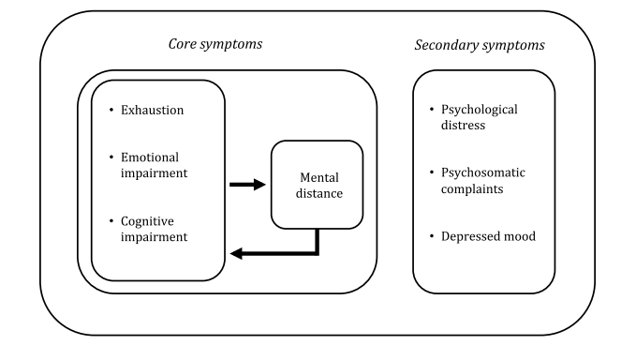
Burnout Assessment Tool (BAT)
A new scale developed at KUL.
FR/NL/EN
The goal
updated (Belgian) standards
an instrument that better meets the current model of balance between what the person invests in his work and what it derives from it.
This instrument will also assess stress or cognitive symptoms
6 short scales
Core symptoms
Exhaustion (8 items)
Mental distance (5 items)
Emotional impairment (5 items)
Cognitive impairment (5 items)
Secondary symptoms
Psychosomatic complaints (5 items)
Psychological distress (6 items

Slide 29
Other available tests
The Shirom Melamed Burnout Measure,
The Copenhagen Burnout Inventory
Only one dimension : exhaustion (personal, professional and relational)
Recommanded by the Swiss Network of Experts for its availability and ease of interpretation.
Preventing Burnout (PBT)
Developed by UCL to assess the risk of burnout for each individual and within the organisation
https://www.preventingburnout.com/fr/la-methodologie
Notes:
Notre modèle permet d'identifier et de mesurer une série d'indicateurs permettant d'analyser le risque de burnout pour chaque individu mais aussi pour l'ensemble du périmètre de l'organisation:
facteurs sources de stress chroniques
sous-facteurs de stress chroniques
modes : faits et perceptions
types d’épuisement
agents de responsabilité

Slide 30
Scales for differential diagnosis
Vierdimensionale Klachtenlijst (4DKL),
Hamilton Depression Scale (HAMD)
Beck Depression Inventory (BDI)
! in addition to the anamnesis and clinical criteria!

Slide 31
5. Prevalence
Lack of a universally recognized definition
Lack official diagnostic criteria standards
Difficult to have prevalence figures for burnout.
For the moment, there is no reliable and scientifically valid estimate of the prevalence of burnout.
Notes:
Given the current lack of a universally recognized definition and official diagnostic criteria standards, it is very difficult to have prevalence figures for burnout.
Moreover, when these figures are available, they are very difficult to compare because of cultural differences and differences in the methodologies used. So, for the moment, there is no reliable and scientifically valid estimate of the prevalence of burnout. One can only note some figures from particular studies, which are however not comparable between them.

Slide 32
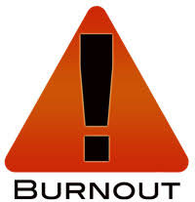
5. Prevalence
Mental health problems = one of the most important causes of absence from work.
According to the European Agency for Health and Safety at Work, stress is also the second most common health problem in the world of work.
In Belgium, 32.7% of workers report experiencing work-related stress for most or all of their working time
The Belstress study → stress is responsible for 50 to 60% of absenteeism.
long-term sick leave resulting from mental disorders, including stress, increased by 74% in Germany between 1995 and 2002
In the Scandinavian countries, absences related to stress increased between 2010 and 2015 by 119%
There is a suicide professional daily in France
These problems therefore represent enormous costs, both in terms of human suffering and terms of economic performance reduction
Notes:
Mental health problems are currently one of the most important causes of absence from work. This type of pathology, which has been increasing in recent years, often leads to long periods of disability and a significant risk of relapse. According to the National Institute for Disability and Health Insurance (INAMI), disability for mental disorders accounted for 35% of total disability in 2014, and partly explained the increase in
the number of disabled people in recent years (more than 25% increase between 2010 and 2015).
In 2016, there were still 20,000 long-term disabilities more than in 2015. However, stress, moral harassment and burnout have more and more impact on health, and are a source of psychological distress or even of pathologies. (ILO, 2000). According to the European Agency for Health and Safety at Work, stress is also the second most common health problem in the world of work. In Belgium, 32.7% of workers
report experiencing work-related stress for most or all of their working time (European Working Conditions Survey 2015).
The Belstress study also showed that stress is responsible for 50 to 60% of absenteeism. According to the European Observatory on Working Conditions, long-term sick leave resulting from mental disorders, including stress, increased by 74% in Germany between 1995 and 2002 (Dewa et al., 2011).
In the Scandinavian countries, absences related to stress increased between 2010 and 2015 by 119% (personal communication from Kristina Alexanderson to Elke Van Hoof on 05.06.20172).
In addition, burnout often results in absenteeism and presenteeism (Wallace et al.
2009; Embriaco et al., 2007; Moors et al., 2001; Peterson et al., 2008). We must also take
suicide risk: Trontin et al. (2009) believe, for example, that there is a suicide
professional daily in France.
These problems therefore represent enormous costs, both in terms of human suffering and
terms of economic performance reduction. According to a survey of the European Agency
for health and safety at work (EU-OSHA, 2014), work-related stress would cost each
year € 25.4 billion in the European Union. The European project Matrix (2013) meanwhile
estimated at € 617 billion per year the cost of work-related depression in Europe (including
presenteeism and absenteeism, loss of productivity, health costs and allowances
disabilities. This project also showed that every euro spent in a program of
promotion and prevention (improvements to the work environment, stress management and
psychological treatments) generates a net economic benefit of € 10.25.
Envoyer des commentaires
Historique
Enregistré
Communauté

Slide 33
5. Epidemiology
72% of employees say they feel stress
86% of executives say they are more and more stressed
Two out of three workers sleep poorly from Sunday to Monday
The European Union estimates the cost of stress in member countries to more than 20 billion euros

Slide 34
5. prevalence
Lyon:
400 pilots/co-pilots or flight crew
Dozen of “declared” burnout
Half concerns pilots!
What about the undeclared?

Slide 35
What about Belgian Defense?

Slide 36
10 most stressful jobs of 2015
1. Firefighter
2. Military personnel
3. Military general
4. Pilot
5. Police officer
6. Actor
7 . Broadcaster
8. Event coordinator
9. Photojournalist
10.Newspaper reporter
SOURCE: CareerCast.com is the Internet's premier career site for finding targeted job opportunities by industry, function and location

Slide 37
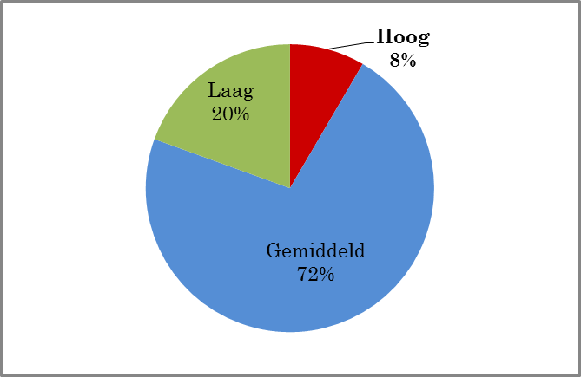
8,4 % of defense employee have a really high risk of burnout (2015)
Bron: Aerens, S, Hongenaert, T, Studie over het welzijn op het werk bij het personeel van Defensie,Technical Report, Competentiecentrum Well Being Psychosociale Steun, Stafdepartement Well Being, 2015, pp.46

Slide 38
What about the flight crew and ATC within the Belgian Defense?

Slide 39
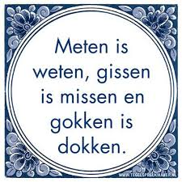
5. Prevalence

Slide 40
6. Risk factors
Burnout can be generated by:
individual factors
societal factors
organizational factors
Interpersonal factors

Slide 41
Individual Factors
Can make a person more vulnerable to burnout
Can strengthen an individual
The individual factors are:
Personality
Demographic characteristics
Attitudes towards work
Notes:
Individual factors can weaken a worker, making him more vulnerable to burnout. However, some personal characteristics can also strengthen the worker, protecting him from burnout. On the side of the individual factors, were thus listed, in the report of Hansez et al. (2010) demographic characteristics, personality and attitudes towards work.

Slide 42
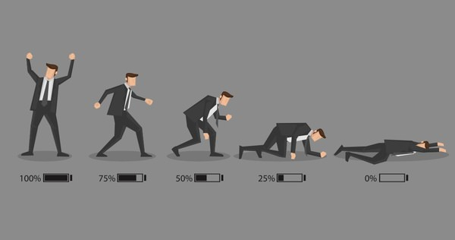
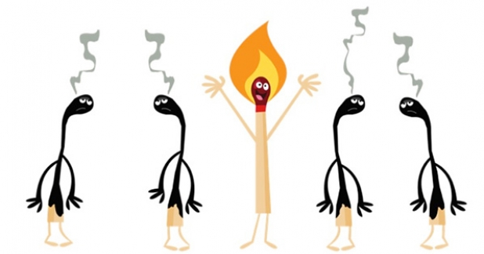
Individual factors: personality
Are you a good candidate to burn-out
?
Notes:
quizz

Slide 43
Question 1
Are you someone meticulous or perfectionist?
Or
Do people say that you are meticulous or perfectionist?
YES = 1 point
NO = 0 point

Slide 44
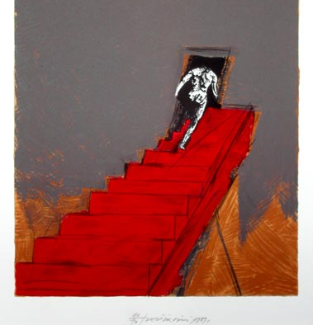
Question 2
Do you have high standard for you or for others?
Or
Do people say that your are demanding for you and for others?
YES = 1 point
NO = 0 point

Slide 45
Question 3
Do you ask easily for help?
YES = 0 point
NO = 1 point

Slide 46
Question 4
True = 1 point
False = 0 point
You do not fly away from challenges

Slide 47
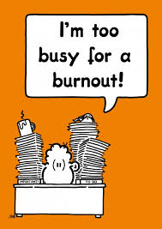
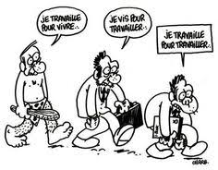
Question 5
True = 1 point
False = 0 point
I devote too much time to my work at the expense of my hobbies or my social life.

Slide 48
Individual factors: personality
Are you a good candidate to burn-out?
Results:
Close to 5? Congrats your are a GOOD candidate for burnout!
These are the best of your employees who are candidates for the Burn-Out and not the slackers!
Notes:
In their review, Alarcon et al. (2009) showed that self-esteem, feeling of effectiveness, locus of control, emotional stability, extroversion, conscientiousness, optimism, proactive personality, positive and negative affectivity and courage were significantly related to burnout.
On the other hand, some people have high expectations for their work, regarding both the nature of work and the performance at work. Some studies have shown that if these expectations were unrealistic, they could lead to burnout (Maslach, et al., 2001).

Slide 49
Individual factors: demographic characteristics
Age?
Level of education
Conjugal status
Gender?
Notes:
With regard to individual characteristics, the link between burn-out and, on the other hand, gender, age or level of education, is not established.
The results of the studies are divergent.
Gender does not seem to be an important predictor of burnout.

Slide 50
Individual factors
Age?
Notes:
Age is the demographic variable that is most related to burnout: the youngest would be more likely to burnout. However, there is a "healthy worker effect" effect (Schaufeli & Buunk, 2003;
Shah, 2009) that age also selects "burnout resistant" workers.

Slide 51
Individual factors
Age?
The most related to burnout
Young > old
! Healthy worker effect!
Notes:
Age is the demographic variable that is most related to burnout: the youngest would be more likely to burnout. However, there is a "healthy worker effect" effect (Schaufeli & Buunk, 2003;
Shah, 2009) that age also selects "burnout resistant" workers.

Slide 52
Individual Factors
Level of education?
Notes:
People with higher education appear to be more susceptible to burnout, probably because they hold positions of greater responsibility, or have higher expectations of their work (Maslach, et al., 2001). ).

Slide 53
Individual Factors
Status level?
Socio-economic
« marital »
Social support?
Notes:
At the conjugal status level, single people, and especially men, are more likely to suffer from burnout. Indeed, the social support of the partner can reduce the effects
burnout (Schaufeli & Buunk, 2003).

Slide 54
Individual factors
Gender?
Notes:
Gender does not seem to be an important predictor of burnout.
At the conjugal status level, single people, and especially men, are more likely to suffer from burnout. Indeed, the social support of the partner can reduce the effects
burnout (Schaufeli & Buunk, 2003).
People with higher education appear to be more susceptible to burnout, probably because they hold positions of greater responsibility, or have higher expectations of their work (Maslach, et al., 2001). ).

Slide 55
Individual factors
Gender?
Not an important predictor
Men > woman
Notes:
Gender does not seem to be an important predictor of burnout.
At the conjugal status level, single people, and especially men, are more likely to suffer from burnout. Indeed, the social support of the partner can reduce the effects
burnout (Schaufeli & Buunk, 2003).

Slide 56
Individual factors: attitudes towards work
Affect
Tendency to feel negative emotions
Identification to the organization
Involvement/ implication
Psychological
continuity
Passion
Increasing vulnerability to burnout if the individual has no impact on the activity for which he/she is passionate.
Commitment
Job satisfaction
Low → higher risk of burnout
Notes:
Affect: The tendency to feel negative emotions positively influences the dimensions of burnout (Rouxel, Michinov & Dodeler, 2016). The feeling of personal accomplishment increases in people who experience more positive emotions (affects) (Mojsa-Kaja & al., 2015).
b. Identification: Identification with the organization allows the worker to perceive greater social support, thus reducing the burnout score (Avanzi, Schuh, Fraccaroli & van Dick, 2015).
Job satisfaction: Low job satisfaction is associated with a higher risk of burnout (Amoafo & al., 2015).
d. Commitment: In the circular model of well-being at work, burnout appears to be the opposite of engagement (Mäkikangas & al., 2015). While engagement is characterized by high activation and a sense of pleasure, burnout is defined as disabling and feeling unwell. However, the question of whether burnout and engagement are two poles of the same continuum or two distinct concepts has not yet been decided.
(Goering, Shimazu, Shou, Wada & Sakai, 2017). In fact, for the majority of people, the increase in the size of burnout goes hand in hand with the decrease in the size of engagement (Mäkikangas, Hyvonen & Feldt, 2017). For its part, Sonnentag (2017) suggests a first distinction: commitment is a state that can be observed only in the accomplishment of a task even if its consequences can resonate in the private life whereas the burnout and especially the Exhaustion will remain after the completion of a task, even outside of work....
Involvement: If affective involvement (psychological attachment through a sense of loyalty and pride in the organization) reduces burnout, continuity involvement (staying in the organization due to the high cost of a departure ) would increase the likelihood (Garland, Lambert, Hogan, Kim & Kelley, 2014). However, according to Li (2014), involvement should rather be studied as a consequence of burnout.
f. The passion: Fernet, Lavigne, Vallerand and Austin (2014) are interested in passion among teachers. People who are passionate about their work are often seen as vulnerable to burnout. However, when the worker has an impact on the activity for which he is passionate, passion becomes a protective factor of burnout (Fernet & al., 2014). If the worker has no impact on this activity, passion will promote burnout.

Slide 57
Risk factors
According to most research, the characteristics of the work environment are more important determinants of burnout than individual characteristics.

Slide 58
6. Risk factors
Classically Burn-Out syndrome would appear particularly in occupations that require:
- FLAME,
RELATIONAL CAPACITIES,
STRESS exposure
However, statistically Burn-Out is observed in ALL occupations
Notes:
a FLAME, a vocation, where the success of the action depends essentially on its RELATIONAL CAPACITIES, exposed to stress, constraints and frustrations.

Slide 59
Societal factors
Burnout is linked to changes in society
Several types:
Increased time pressure
Increased multi-tasking
Reinforcement of individualism
Intensifying competition
Digitalisation/technological development
Performance pressure
Importance of success
Notes:
According to several authors, burnout is linked to recent changes in society (Kaesemans et al., 2016). These evolutions would be of several types:
- increased pressure of time, linked to the multiplication of roles and tasks of everyone likely to come into conflict (in terms of time to share, mutual influences, expectations that may be different in different roles etc.);
- reinforcement of individualism, in a society that has lost its traditional social networks, and where social relations are based more on competition than on solidarity. The individual has also become the sole culprit of his successes and failures;
digitalisation, which imposes immediate and continuous reactions;
the pressure of performance, and the importance of success, become central in the sense given to life. We must always do more and better, both at work and in leisure, which must always bring new experiences.
Perilleux and Vendramin (2017) also believe that the current model of society, focused on performance, is a source of burnout because it does not allow to recognize personal failings, social contradictions, the pulling of values.

Slide 60
Risk factors : organizational factors
Reminder: Burnout is defined in a particular professional and organizational context and results from a prolonged exposure to a set of factors, which causes an imbalance between the resources available to the individual and the demands of his work.
Situational factors
Organizational characteristics (rules, flexibility, job security)
Characteristics of the profession
Work-specific characteristics
Notes:
Burnout is defined in a particular professional and organizational context and results from a prolonged exposure to a set of factors, which causes an imbalance between the resources available to the individual and the demands of his work.
As a reminder, situational factors refer to organizational characteristics (eg organizational rules, organizational changes and flexibility practices, lack of job security), work-specific characteristics, specifically job demands (eg workload , time pressure, role conflict) and the lack of resources at work (eg social support, feedback, autonomy) and finally the characteristics of the profession, including the importance of emotional work (Mojsa- Kaja et al., 2015 ).

Slide 61
Organizational factors : Areas likely to generate psychosocial risks
The work organization
the organizational structure (horizontal-vertical),
Task distribution
Work procedures
Management
Corporate culture
the task of the worker as such:
the complexity and the variation of the tasks,
the emotional demands (relation with the public, contact with the suffering, having to hide his emotions, etc.),
the mental load,
the physical burden
The content of the work
Notes:
work organization: in particular the organizational structure (horizontal-vertical), the way in which tasks are distributed, the work procedures, the management tools, the management style, the general policies carried out in the company;
- the content of the work: the task of the worker as such: the complexity and the variation of the tasks, the emotional demands (relation with the public, contact with the suffering, having to hide his emotions, etc.), the mental load, the physical burden, the clarity of
tasks;

Slide 62
Organizational factors : Areas likely to generate psychosocial risks
the working conditions
the types of contracts and schedules (night work, shift work, atypical schedules, ...)
learning opportunities
management careers
evaluation procedures
living conditions at work
the physical environment in which the work is performed:
the layout of workplaces,
work equipment,
noise,
lighting
Notes:
- the working conditions: the methods of execution of the employment relationship: the types of contracts and schedules (night work, shift work, atypical schedules, ...), learning opportunities, management careers, evaluation procedures;
- living conditions at work: the physical environment in which the work is performed: the layout of workplaces, work equipment, noise, lighting, used, working positions

Slide 63
Risk factors: interpersonal factors
Interpersonal relationships may inhibit or otherwise promote the onset of burnout.
Leadership
Communication
Support
Relationship quality
Colleagues
Team cohesion
Communication
Relationship quality
Notes:
interpersonal relations at work: this brings together the internal relations (between the workers, with the direct leader, the hierarchical line, ...) but also the relations with the thirds, the possibilities of contact, the communication. We consider the quality of relations (cooperation, integration ...).

Slide 64
Risk factors
The organizational factors of risk (constraints) and protection (resources) would be mainly of four types:
Interpersonal
Social support
Related to tasks
Perceived workload
Feedback
Skills
Resources
Related to growth
Career opportunities
Fair recognition of the work
Related to the organization
Notes:
interpersonal, for example social support. The social support of an individual is conditioned by the quality of interpersonal relationships with colleagues and superiors, by the solidarity and trust existing between people, by their competence and availability, by the recognition of their work, but also the existence of groups or spaces for discussion and regulation for workers;
- related to tasks (workload (perceived), control, feedback, variety of tasks, use of skills, resources available);
- related to growth (eg career opportunities). In particular, it is important to ensure fair recognition of the work. Burnout is linked to a strong imbalance between the constraints and resources of the individual. The worker should not have the
feeling of a lack of reciprocity between what he invests in his professional activity and what he receives in return, especially in terms of recognition, and particularly in relation to what his colleagues give and receive in return. It is therefore necessary to be transparent and fair in everyone's recognition processes;
- related to the organization (for example, possibilities of participation: the worker must be able to participate in decision-making, his opinion must be able to be listened to and taken into account.

Slide 65
7. Interventions
Interventions can also be classified according to their target
the individual
the environment.
Interventions to reduce stress-related problems are traditionally classified into three categories:
Primary interventions
Secondary interventions
Tertiary interventions
Notes:
1) Primary interventions aim to reduce risk factors in order to prevent the development of burnout.
2) Secondary interventions target a group of workers who are showing the first signs of suffering and who have a high probability of developing a burnout. We also talk about maintaining employment.
3) Tertiary interventions target workers who are already suffering from burnout. These interventions are often associated with the need to set up support for the return to work.

Slide 66
Primary and secondary interventions
Improve the relationship between the doctor/psychologist and the individuals
Good stress management system (toolbox)
Peer support system
Prevention → Well-being
Information adapted to the population
Information for the management

Slide 67
WHAT WE NEED TO LEARN
Mental illness is like any other sickness !
Mental illness can strike anyone.
Mental illness can be cured.
Mental illness is not contagious, you can not catch it by being kind
Getting help when sick with mental illness is important for recovery and a must for people working in aviation .
Warning signs should be reported.
REPORTING WARNING SIGNS
IS A
SOCIAL & PROFESSIONAL DUTY
SOURCE: “Pilot well-being & mental illness” by Abdur Syed & Ricardo Sousa

Slide 68
Tertiary interventions
Burnout = alarm → changes are required!
To shelter:
generally prolonged incapacity for work (on average 4 months)
There are no drugs against Burn-Out
The only treatments are:
Psychotherapy
Lifestyle change
Notes:
Burnout should be seen as an alarm that stops a lifestyle that is not sustainable. We must therefore act on the personal and professional spheres of the individual, and allow him successively, rest, rebuild, think and find the desire to work, and finally return to work.
The actions implemented must in any case concern both the worker and his work environment, so that the same causes do not reproduce the same effects (possibly also for other workers). The person could recover his functioning and participate in his social roles on average in 3 months. This duration is obviously indicative, as it can vary greatly from one individual to another. Depending on the person and the condition (including fatigue) in which she was initially, more time may be required.
If incapacity for work may nevertheless be necessary to avoid risk, it is in any case useless to be unable to work without support. The process should be accompanied at least every three weeks, and appropriate interventions should be carried out in a timely manner. The therapy must be activating, aiming for solutions and be directed to recovery of functioning. The treatment also requires an active involvement of the person in the process, as well as his environment.

Slide 69
Psychotherapy provided by a trained heatlth professional independent of the employer!
Crisis phase (min. 3 weeks)
Understanding and accepting the conditions
Working on the problems and finding solutions (min 3 weeks)
match the person's resources with the demands of the job
identify the strengths, resources and weaknesses of the profession
Application of the solutions (on average, 3 to 6 weeks).
apply the solutions found in his daily situation (work, private, social) to better meet his needs.
help the worker to find a way to respond to the conditions responsible for burnout.
Balance must be found between time spent at work versus home time.
Notes:
This support must be provided by a trained health professional, that is to say, who has clinical expertise coupled with knowledge of the workplace and psychodiagnosis, independent of the employer or control bodies. We must also pay attention to the intervention modules that are
develop within the professional environment (eg prevention services). These structures, as well as the occupational physicians, do not have the task of carrying out diagnostic and / or therapeutic work,
The first step is the phase of the crisis. Understanding and acceptance are the first conditions to go further. We must indeed be able to identify and accept the different feelings (anxiety, anger, guilt, shame, failure, fear ...) that we feels, to be able to manage them. This phase can take a minimum of 1 to 3 weeks, during which periods of rest must alternate with periods of activity. Explain, offer perspective, explain complaints, advise on the daily structure. Help must be short, fast and direct.
Thee second phase is that of problems and solutions (on average, 3 to 6 weeks). During this phase you have to stimulate the person to leave his individual position and have a more global vision, to find solutions for the factors that contributed to the appearance of burnout. The goal is to match the person's resources with the demands of the job. The person must be allowed to identify the strengths, resources and weaknesses of the profession. We can also identify what we expect from our work, what it means and how important it is, and how we can meet those expectations, including the amount of work needed and the stress that one feels able to handle. Unmet or unrealistic expectations play an important role in burnout. It is therefore important to understand the aspects of the work that are not compatible with the worker's goals, aspirations or personality.
We can then develop more constructive adaptation models, and explore other professional perspectives.
The intervention therefore focuses on matching the performance requirement with the available resources, on the correction of dysfunctional attitudes and behaviors, as well as on the ability to lead a way of life corresponding to the values ​​and objectives. crucial for personal identity.
The third phase is that of the application of the solutions (on average, 3 to 6 weeks). In the application phase, the person is stimulated to apply the solutions found in his daily situation (work, private, social) to better meet his needs. We will put in place actions to reduce the sources of stress that have been identified and help the worker to find a way to respond to the conditions responsible for burnout. It is the person himself who has to develop a scheme with his personal and social activities, including work. Balance must be found between time spent at work versus home time.

Slide 70
BACK to work?
Prepared with the individual
Close collaboration between health profesionals, the individuals and the professional environment
Reintegrate the worker!
Not recommended to change work too quickly
Feeling of failure!
Often, after treatment, professional reorientation or mutation. They are grilled with their former colleagues (they manipulated them, showed indifference, => rejection)
Notes:
The return to work must therefore be prepared with the person and his personal and professional environment (employer, human resources, direct manager, colleagues and occupational medicine), and enn guaranteeing a space and a secure intermediate time that allow the individual to rebuild a professional identity. In particular, it is necessary to be able to ensure the benevolence of the working environment.
A close collaboration between health professionals (doctor, psychiatrist, psychologist) and the professional environment (occupational physician, medical adviser, prevention counselor psychosocial aspects ...) must therefore be put in place as quickly as possible. Professionals must also know the limits of their field of expertise and know when it becomes necessary to involve other professionals. The health professional who intervenes must therefore have contact with the workplace and be able to exert a concrete influence over it. He must assist the person in an interview with the employer and discuss the gradual reintegration and the required adjustments to the work. workplace.
It is also not recommended to change jobs too early, at the risk of reinforcing the feeling of failure and starting on a bad footing in a new environment. Instead, we must first try to identify the problems in the current job and to take action in the face of sources of stress.
If all attempts to eliminate sources of stress or to change the workplace have failed then it is necessary to think carefully, for example by realistically defining the appropriate employment for the person
The exchange of information must always be done with the agreement of the person: it is of course in this context must respect the medical confidentiality and confidentiality of medical and individual data. Ideally, this consultation is done among the professionals who come within the framework of the royal decree regulating the health professions in order to guarantee the respect of the shared secret.

Slide 71
THE STIGMA OF MENTAL HEALTH IN AVIATION
- Aircrew fear suspension of flying duties, license,…,financial impact.
- ”Suck it up and do the job” culture.
Aircrew reported rates of mental problems is lower than the general public
“Suffer in silence situation”
HAZARD REMAINS (HIDDEN) UNTIL BREAKDOWN / MISHAP
SOURCE: “Pilot well-being & mental illness” by Abdur Syed & Ricardo Sousa

Slide 72
Thank you for your attention
Questions?
Emilie.dessy@mil.be

